Slide 1

Group 8
DATA7001 Introduction to Data Science
Group Project
Notes:
Planned duration for this slide: 0:15.

Slide 2
Group 8
Siamak Adeli Koodehi
Cristhyan Cardona Garcia
Matthew Colwell
Christopher Symons
Hai Hung Vu
Notes:
Planned duration for this slide: 0:15.

Slide 3
The Problem (Solving with Data)
1
2
3
Notes:
Planned duration for this slide: 0:45.

Slide 4
[ initial live demo of web tool here ]
1
2
3
Notes:
Planned duration for this item: 0:30.

Slide 5
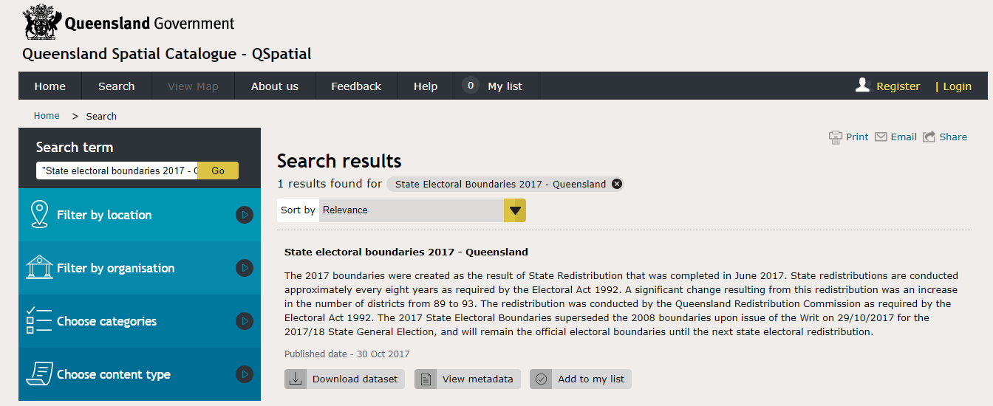
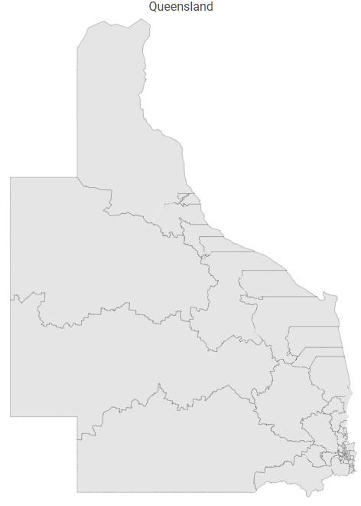
Getting the Data (I need)
Electoral boundaries (shapefile Map)
Notes:
Planned duration for this slide: 1:00.

Slide 6
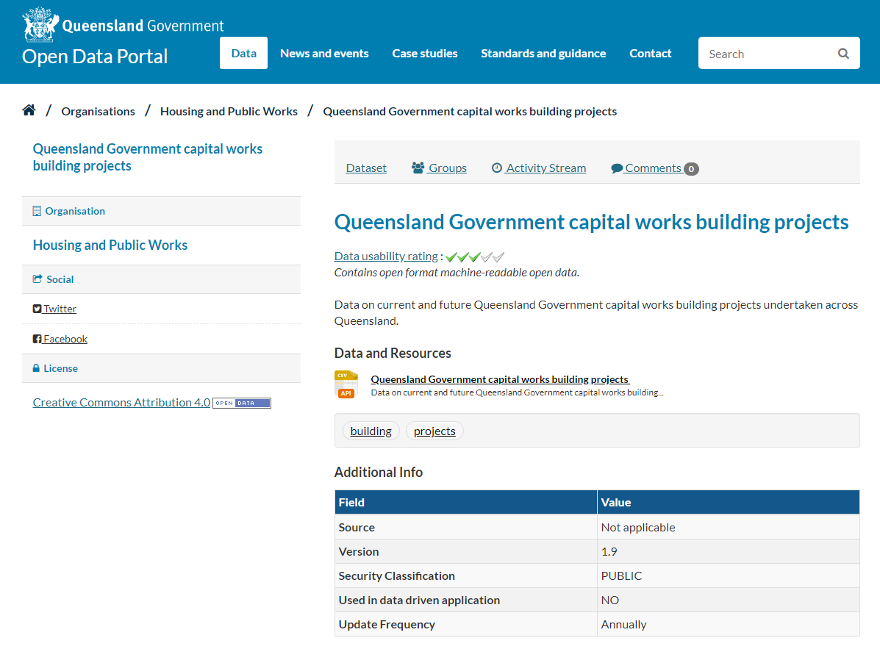
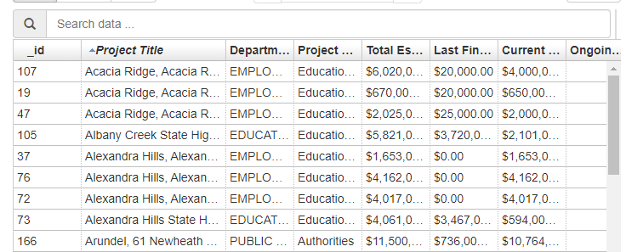
Getting the Data (I need)
Infrastructure projects (CSV)

Slide 7
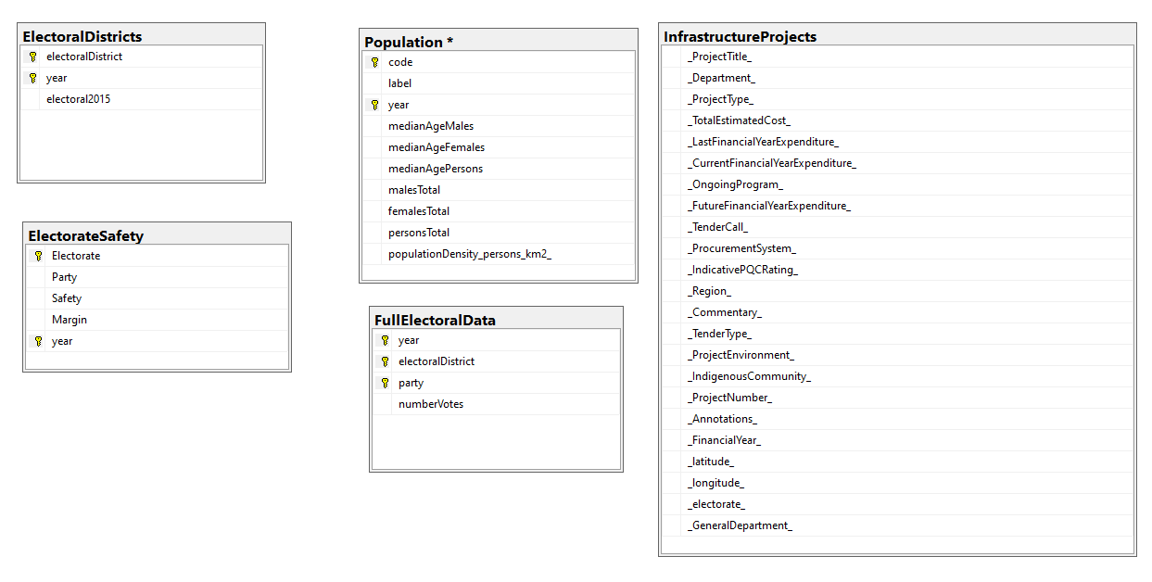
Getting the Data (I need)
Database

Slide 8
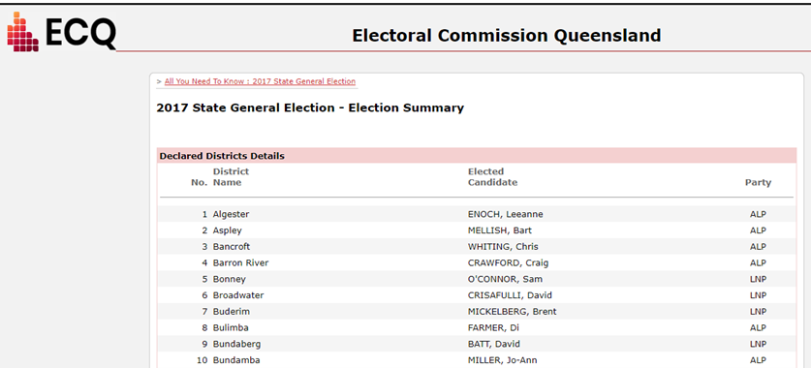
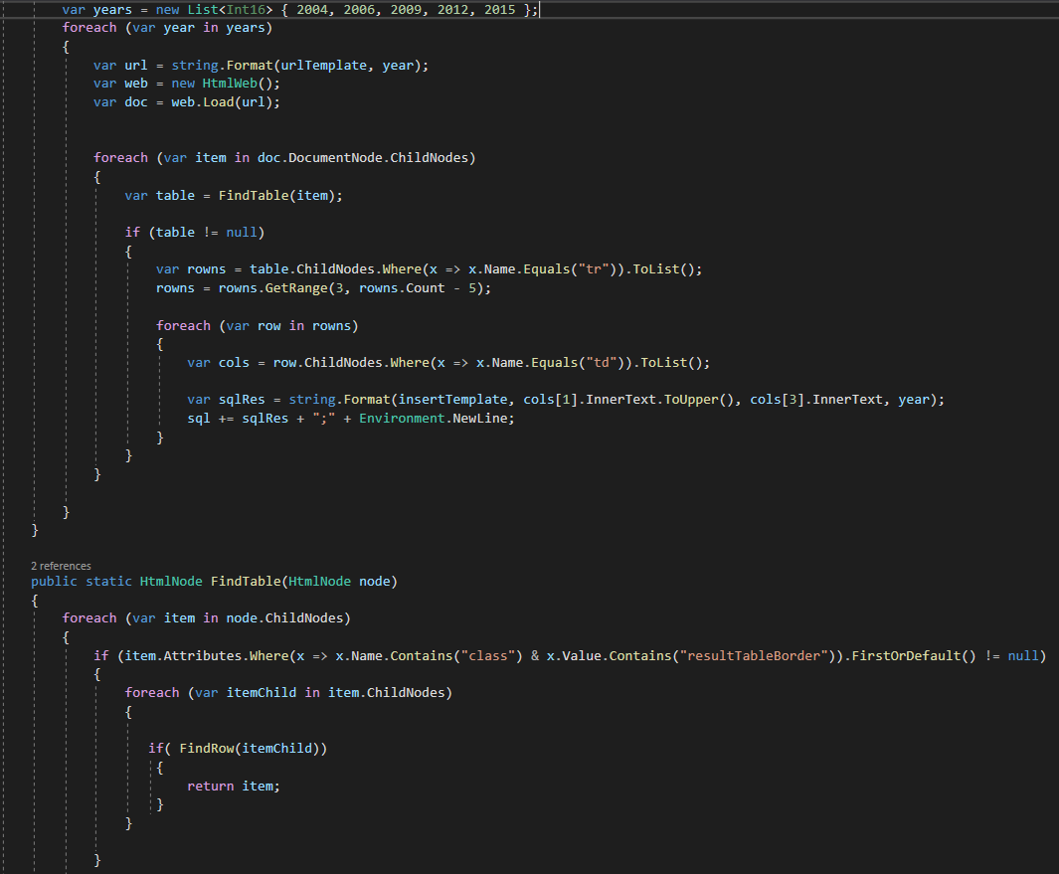
Getting the Data (I need)
Electoral Data (Web Scraping)

Slide 9
Is my data fit for use?
1
2
3
Notes:
Planned duration for this slide: 0:30.

Slide 10
Making the data confess
1
2
3
Notes:
Planned duration for this slide: 1:00.

Slide 11
[ live demo / storytelling with data ]
1
2
3
Notes:
Planned duration for this item: 2:00.

Slide 12
Conclusion
1
2
3
Notes:
Planned duration for this slide: 0:30.

Slide 13
Thank you / any questions
1
2
3
Notes:
Planned duration for this slide: 0:15.

Slide 14
?References
Maybe we should have this… maybe not.
Would be along lines of what’s requested in project specification document: “An appendix listing the names and sources of the data sets as well as code libraries, or tools you used in your project”
Could be too much to fit on a slide.
Notes:
Planned duration for this slide: 0:00.

